Slide 1
IMPACTED THIRD MOLAR SURGERY & COMPLICATIONS
Prof. Shadab Mohammad
Professor and Head,
Department of Oral and Maxillofacial Surgery,
Faculty Of Dental Sciences,
King George’s Medical University,
Lucknow,
India.

Slide 2
DEFINITIONS:
IMPACTED TOOTH
IMPACTED TOOTH IS DEFINED AS THE TOOTH WHICH HAS ALREADY PASSED CHRONOLOGICAL AGE OF ERUPTION AND FAILED TO COME TO ORAL CAVITY INSPITE OF NORMAL ERRUPTIVE FORCES DUE TO SOME MECHANICAL OBSTRUCTION.
UNERUPTED TOOTH
A TOOTH THAT FAILS TO ERUPT DUE TO LOSS OF ERUPTIVE FORCES.

Slide 3
Origin – Latin– Impactus
Impactus: Cessation of eruption caused by physical barrier / ectopic eruption.
An impacted tooth is partially erupted or unerupted tooth and is positioned against another tooth , bone or soft tissue so that its further eruption is unlikely and will not eventually assume a normal arch relationship with the other teeth or tissues

Slide 4
Cessation of eruption before gingival emergence without a specific physical barrier or ectopic positioning is called primary retention, e.g. Endocrinal disturbances
Arrested eruption of tooth after initial emergence without any obvious barrier is called secondary retention,e.g. Ankylosed tooth

Slide 5
CAUSES OF IMPACTION
LOCAL
Lack of Space b/w 2nd molar and ramus.
Overretained decidous teeth.
Ectopic position
Dilaceration of roots
Inclination of tooth
Associated soft tissue or bony pathology
Heredity
Endocrinal causes

Slide 6
SYSTEMIC
Prenatal
Heredity
Miscegenation
Postnatal Causes
Rickets
Anemia
Congenital Syphilis
Tuberculosis
Endocrine Dysfunctions
Malnutrition
Rare Causes
Clediocranial Dysostosis
Oxychephaly
Progeria
Achondroplasia
Cleft Palate

Slide 7
CLASSIFICATIONS OF MANDIBULAR THIRD MOLAR IMPACTION
Winter’s Classification (1926):
Based on angulations : according to the position of the impacted third molar to the long axis of second molar
Mesioangular -45%
Horizontal - 10%
Vertical - 40%
Distoangular – 5%
These may occur simultaneously in:
Buccal version
Lingual version
Torsoversion

Slide 9
WINTER’S SUB CLASSES
The angle between the occlusal plane or line parallel to it and the longitudinal axis of the impacted third molar, in turn, allowed objective classification of the third molars within the Winter subclasses as follows
Third molars with negative angles (_0°) were considered to be inverted
Third molars with an angle between 0° to 30° were considered to be horizontal,
Third molars with an angle between 31° to 60° were considered to be mesioangular,
Third molars with an angle between 61° to 90° were considered to be vertical,
Third molars with an angle _90° were considered to be distoangular.

Slide 10
Pell and Gregory’s Classification(1933) BASED ON THE RELATIONSHIP OF THE THIRD MOLAR TO THE RAMUS OF THE MANDIBLE AND THE SECOND MOLAR

Slide 11
BASED ON POSITION OF HIGHEST PORTION OF THIRD MOLAR WITH OCCLUSAL PLANE
Class I - sufficient amount of space between the ramus and distal of the second molar for the accommodation of the mesiodistal diameter of the crown of the third molar.
Class II - the space between the ramus and distal of the second molar is less than the mesiodistal diameter of the crown of the third molar.
Class III – all or most of the third molar is located in the ramus.

Slide 13
Classifications
Based on depth: according to relationship with the occlusal surface of adjoining second molar between long axis of 2 molar & ascending ramus.
Position A - highest position of the tooth is on a level or above the occlusal line.
Position B - highest position is below the occlusal line but above the cervical level of second molar.
Position C - highest position is below the cervical level of second molar.

Slide 15
ADA-AAOMS CLASSIFICATION
07220- Removal of impacted tooth-with overlying soft tissue. (Requires incision of overlying soft tissue and removal of tooth)
07230- Removal of impacted tooth-Partially bony impaction. (Incision of overlying soft tissues, elevation of flap and either removal of bone and tooth or sectioning and removal of the tooth)
07240-Removal of impacted tooth-completely bony. (Incision of overlying soft tissues, elevation of flap , removal of bone and sectioning of the tooth).
07241- Removal of impacted tooth-completely bony with unusual surgical complications. (Incision of overlying soft tissues, elevation of flap , removal of bone and sectioning of the tooth and/or presents with unusual difficulties and circumstances).

Slide 17
Winters “WAR” lines
White line: Line joining the occlusal surfaces/heighest cusps tips of all erupted molars, extending up to the ramus. It indicates the difference in occlusal level of second and third molars.
Amber line: Represents the bone level distal to the 3rd molar, extended anteriorly along the crest of interdental septum. This line denotes the alveolar bone covering the impacted tooth and the portion of the tooth not covered.
Red Line: Drawn perpendicular from Amber line to the imaginary point of application of elevator on the 3rd molar. It indicates the amount that will have to be removed before elevation i.e. the depth of the tooth in bone and the difficulty encountered in removing the tooth

Slide 19
PEDERSON’S DIFFICULTY INDEX
Very difficult: 7 to 10
Moderataly difficult: 5 to 7
Minimally difficult: 3 to 4
Scoring
Mesio angular 1
Horizontal 2
Vertical 3
Distoangular 4
Level A 1
Level B 2
Level C 3
Class I 1
Class II 2
Class III 3
Large bulbous crown increases the difficulty

Slide 20
WHARFE’S ASSESSMENT
Criteria | Category | Score
Winters Classifications | Horizontal | 2
 | Distoangular | 2
 | Mesioangular | 1
 | Vertical | 0
Height of mandible | 1-30 mm | 0
 | 31-34 mm | 1
 | 35-39 mm | 2
Angulation of 3rd molar | 1-50 deg. | 0
 | 60-69 | 1
 | 70-79 | 2
 | 80-89 | 3
 | 90+ | 4

Slide 21
WHARFE’S ASSESSMENT
Root shape & development | Complex | 3 (more than 2/3 complete)
 | unFavourable curvature | 2 (less than1/3 complete)
 | favourable Curvature | 1
Follicals | Normal | 0
 | Possibly enlarged | 1
 | Enlarged | 2
Path of exit | Space available | 0
 | Distal cusps covered | 1
 | Mesial cusps also covered | 2
 | Both covered | 3
TOTAL |  | 33

Slide 22
SEQUENCE OF PROCEDURE
Isolation.
Anaesthesia
Incision- Flap design.
Removal of overlying bone.
Sectioning of tooth.
Delivery of sectioned tooth.
Smoothening & debridement of socket.
Arrest of haemorrhage
Closure of wound.
Follow up

Slide 23
INCISIONS AND FLAPS
Envelope flap
L- shaped incision
Bayonet shaped incision
Triangular shaped incision
Ward’s incision and Modified Ward’s incision.
Comma shaped incision.
S -shaped incision
Szmyd and modified Szmyd incision
Berwick’s tongue shape flap.

Slide 24
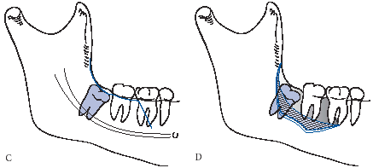
Incision-flap design
Must be of adequate dimensions to allow adequate exposure.
“Bone belongs to the patient and Tooth belongs to you”
Three corner flap…….

Slide 25
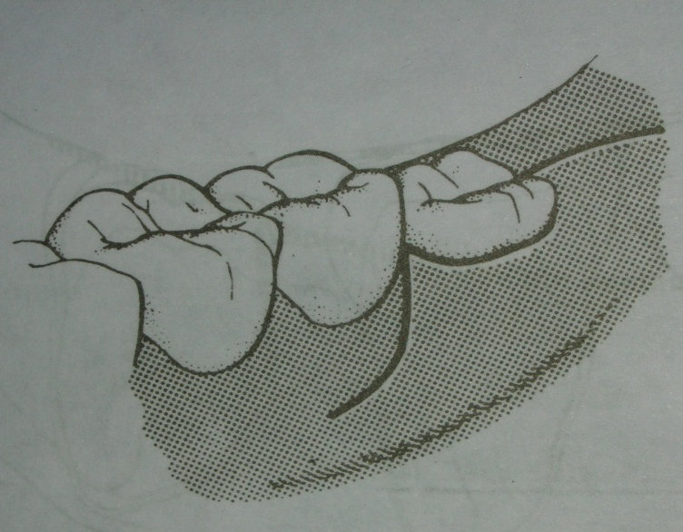
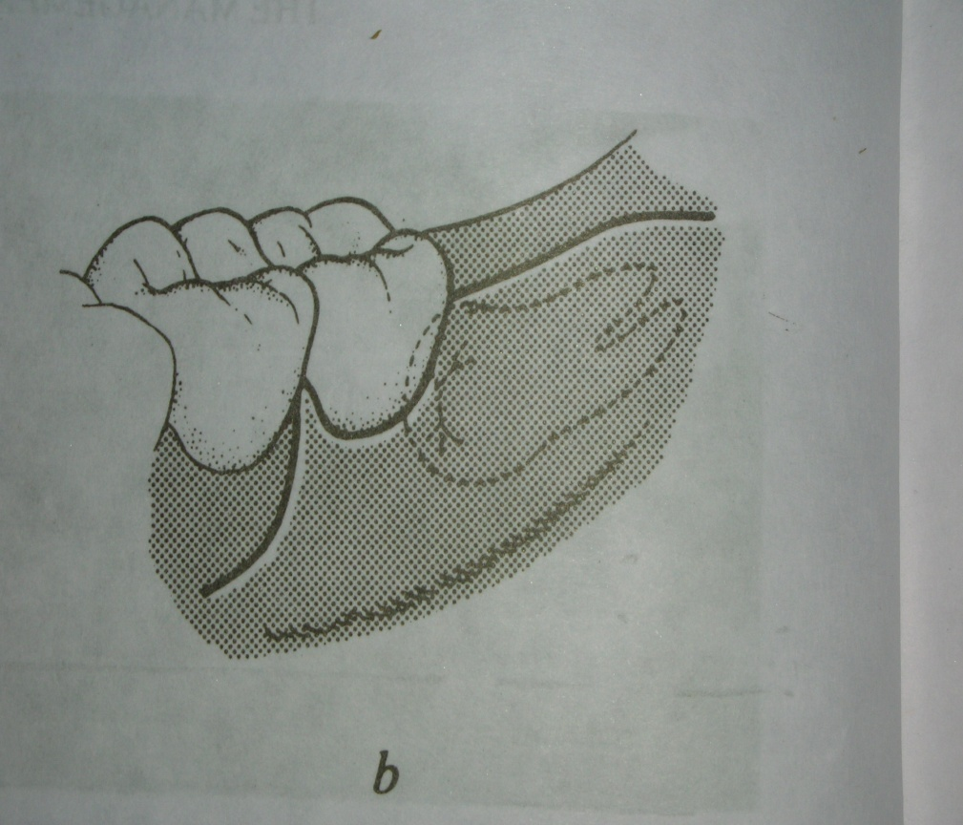
Incision-flap design
Ward’s incision
Modified ward’s incision

Slide 26
ENVELOPE FLAP

Slide 27
TRIANGULAR FLAP

Slide 28
COMMA SHAPED INCISION

Slide 29
SZMYD INCISION(1971)

Slide 30
BARWICK’S TONGUE FLAP(1966)

Slide 31
BAYONET SHAPE INSICION

Slide 32
BONE REMOVAL
BUR TECHNIQUE
(a)Postage stamp technique
(b)Moore and Gillby’s guttering technique
(c)Bowdler Henry’s Lateral trephination(1969)-for germectomy,partialy formed and unerrupted third molar(9-18 yr age)
CHIESEL AND MALLET
(a) through Buccal approach
(b) Lingual split technique

Slide 33
REMOVAL OF OVERLYING BONE
Once the soft tissue is elevated and retracted, the surgeon must make a judgment concerning the amount of bone to be removed.
Bone must be removed in an atraumatic, aseptic, and non–heat-producing technique, with as little bone removed and damaged as possible.
The amount of bone that must be removed varies with the depth of impaction, the morphology of roots, and the angulation of tooth.
The speed of micromotor should be 12000- 20000 rpm.

Slide 34
REMOVAL OF OVERLYING BONE
A large round bur ( No. 8 ) is desirable, because it is an end cutting bur and can be effectively used for drilling with a pushing motion.
The tip of a fissure bur ( No. 703 ) does not cut well, but the edge rapidly removes bone and quickly sections teeth when used in lateral direction.
The bone on the occlusal aspect of the tooth is removed first to expose the crown of the tooth.
Then the cortical bone on the buccal aspect of the tooth is removed down to cervical line.

Slide 35
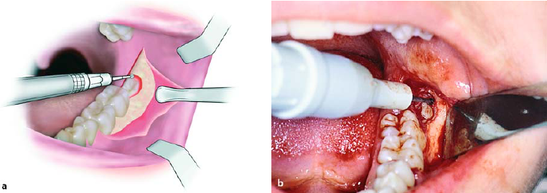
Exposure of the crown of the tooth using a round bur.
a Diagrammatic illustration. b Clinical photograph

Slide 36
REMOVAL OF OVERLYING BONE
Next, the bur can be used to remove bone b/w the tooth and the cortical bone in the cancellous area of the bone with a maneuver called ditiching.
This provides access for elevators to gain purchase points and a pathway for delivery of tooth.
No bone should be removed from lingual aspect so as to protect the lingual nerve from injury.

Slide 37
SECTIONING OF TOOTH
Reduces the amount of bone removal required prior to elevation of tooth.
Reducing the risk of damage to the adjacent tooth.
Once sufficient amount of bone removed, the surgeon should access the need to section the tooth.
The direction in which the impacted tooth should be divided depends primarily on the angulation of the impacted tooth & root curvature.

Slide 38
SECTIONING OF TOOTH
The sectioning can be performed with a bur or chisel.
The bur is used by most surgeons, but if a chisel is used it must be sharp.
When the bur is used, the tooth is sectioned three- fourth of the way towards the lingual aspect.
A straight elevator is inserted into the slot made by the bur and rotated to split the tooth.

Slide 39
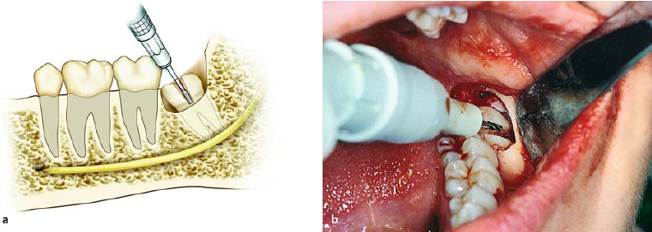
Sectioning of the crown of an impacted tooth, in the buccolingual direction, which extends as far as the
intraradicular bone.
a Diagrammatic illustration. b Clinical photograph

Slide 40
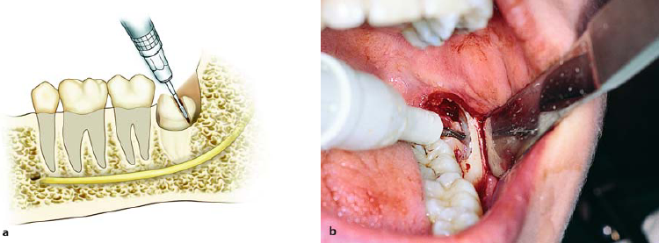
Sectioning of the distal portion of the crown of the impacted tooth using a fissure bur.
a Diagrammatic illustration. b Clinical photograph

Slide 41
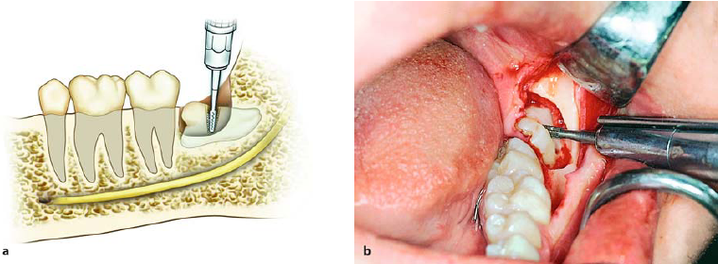
Sectioning of tooth at the cervical line using a fissure bur.
The diagrammatic illustration (a) shows the position beyond which the bur must not proceed, to avoid injury of the inferior alveolar nerve

Slide 42
DELIVERY OF SECTIONED TOOTH
Once adequate bone has been removed to expose the tooth and the tooth has been sectioned in the appropriate fashion, the tooth is delivered from the alveolar process with elevators.
Most frequently used elevators are the straight elevator, the paired cryer elevators .
Application of an excessive force may result in unfavorable fracture of the tooth, of excessive buccal bone, of the adjacent second molar or possibly of the mandible.

Slide 43
DELIVERY OF SECTIONED TOOTH
Luxation of the distal segment of the tooth with rotation of the elevator distally.
a Diagrammatic illustration. b Clinical photograph

Slide 44
DELIVERY OF SECTIONED TOOTH
Luxation of the impacted tooth in the distal direction, after creating a pathway for removal.
a Diagrammatic illustration. b Clinical photograph

Slide 45
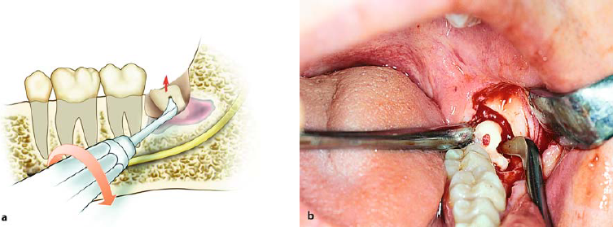
DELIVERY OF SECTIONED TOOTH
Luxation of the root of using an angled Seldin elevator.

Slide 46
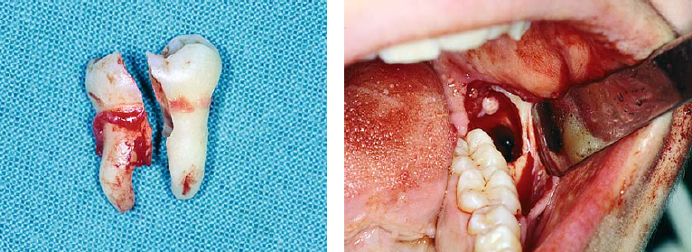
DELIVERED TOOTH & EMPTY SOCKET
Segments of tooth after removal
Empty socket after extraction of tooth

Slide 47
SMOOTHENING & DEBRIDEMENT OF SOCKET
Attention must be given to debriding the wound of all particulate bone chips and debris.
Wound should be irrigated with sterile saline, taking special care to irrigate thoroughly under the reflected soft tissue flap.
Remove any remaining dental follicle and epithelium.
The bone file is used to smooth any sharp, rough edges of bone.
A final irrigation and a thorough inspection should be performed before the wound is closed.

Slide 48
CLOSURE OF WOUND
The closure of the incision should be a primary closure.
The initial suture should be placed through the attached tissue on the posterior aspect of the second molar.
Additional sutures are placed posteriorly from that position and anteriorly through the papilla on the mesial side of the second molar.
Usually three or four sutures are necessary to close an envelope incision.
If a releasing incision was used, attention must be directed to closing that portion of incision as well.

Slide 49
CLOSURE OF WOUND
a Removal of follicle using a hemostat and periapical curette.
b Surgical field after placement of sutures

Slide 50
LINGUAL-SPLIT TECHNIQUE
Described by Sir William Kelsey Fry (1933).
Later popularized by Terence G ward(1956)
Specially for lingually placed tooth.
Modified by Dr. Davis & Lewis in 1960
SURGICAL BASIS OF LINGUAL SPLIT TECHNIQUE
Whenever tooth is extracted
Lingual cortical plate is resorbed

Slide 51
Procedure :
Ward’s or Modified Ward’s incision
Reflection of mucoperiosteal flap
Removal of buccal plate expose the crown chisel is used and section the lingual cortex by planning 45˚angle to upper border and cutting edge parallel to external oblique ridge
3rd molar elevated from mesial aspect.
If it is firm crown it sectioned at cervical

Slide 52
WARD’S INCISION

Slide 53
REFLECTION OF MUCOPERIOSTEAL FLAP

Slide 54
REMOVAL OF BUCCAL CORTICAL PLATE

Slide 55
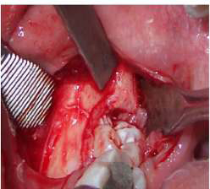
CHISEL BEVEL PARALLEL TO EXT OBLIQUE RIDGE

Slide 56
FRACTURE OF LINGUAL CORTICAL PLATE

Slide 57
REMOVAL OF TOOTH

Slide 58
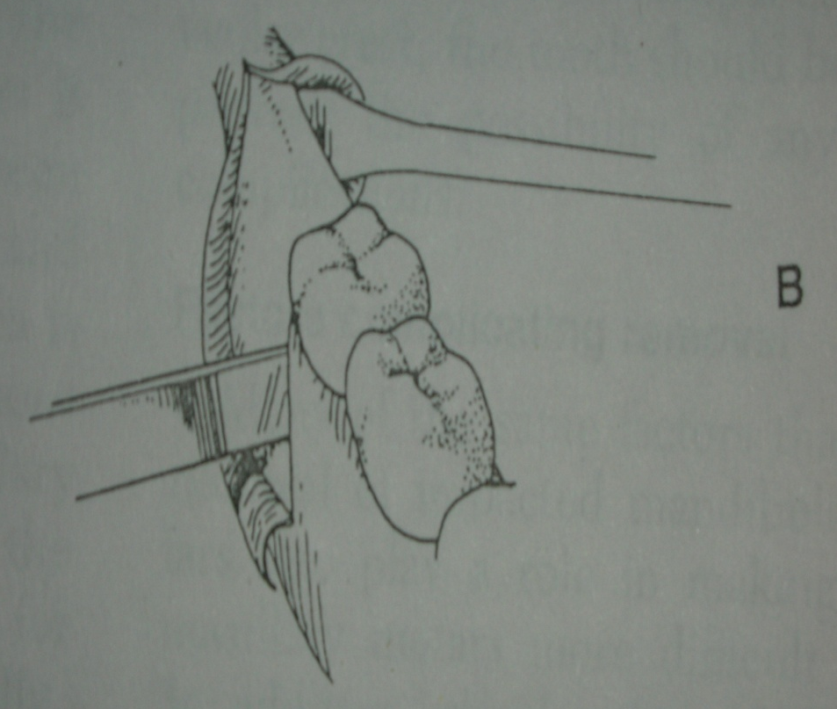
LINGUAL-SPLIT TECHNIQUE

Slide 59
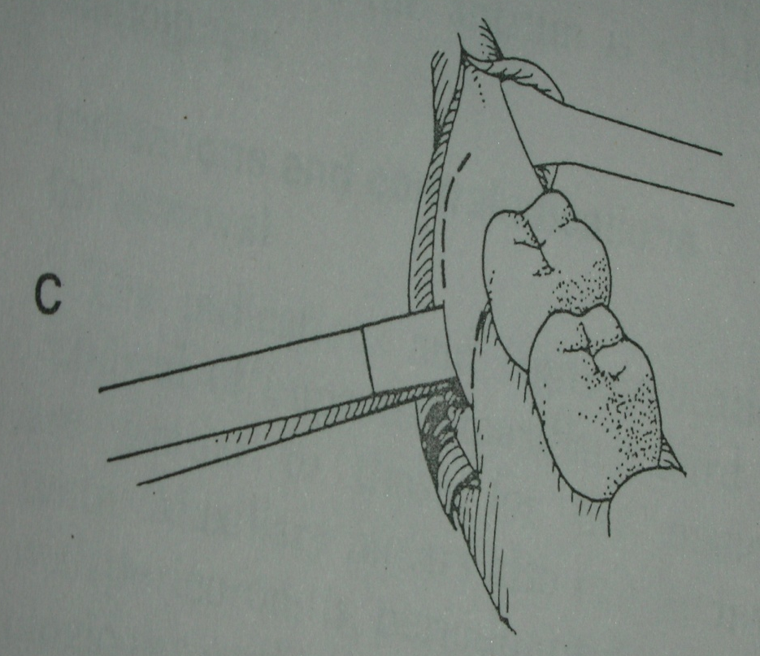
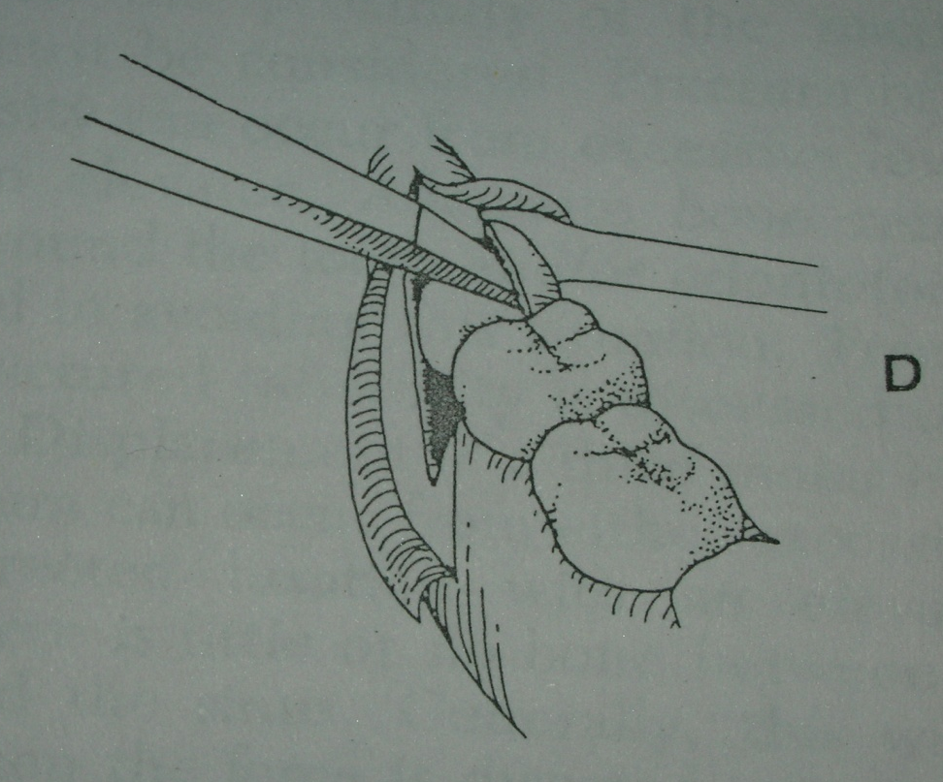
LINGUAL-SPLIT TECHNIQUE

Slide 60
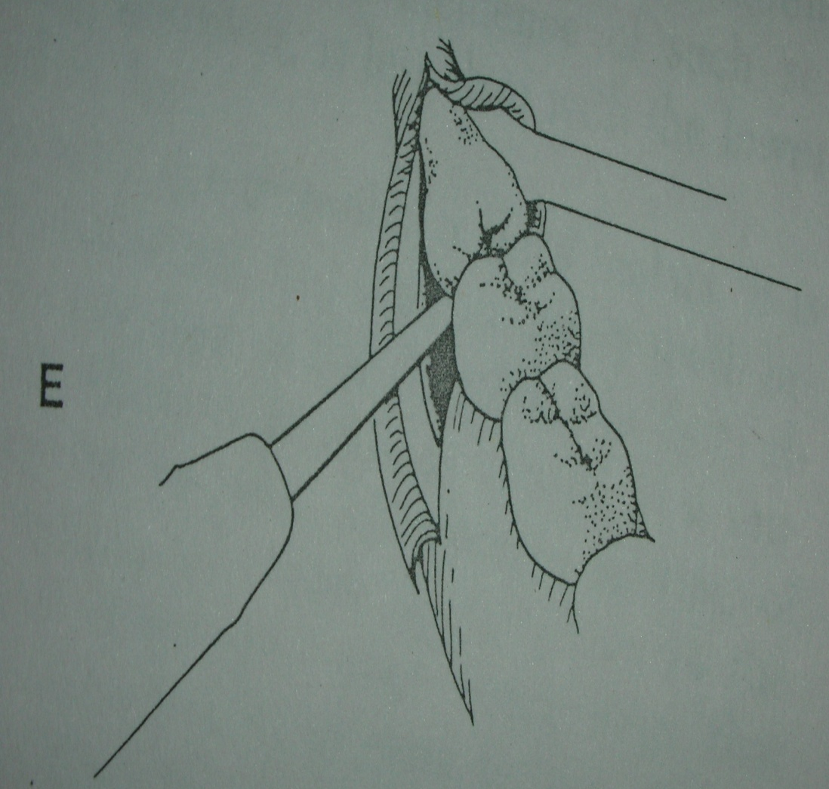
LINGUAL-SPLIT TECHNIQUE

Slide 61
Buccal vs. Lingual approach
Criteria | Buccal | Lingual
Access | Easy in conscious patient | Difficult in conscious patient
Instruments | Chisel and mallet or bur | Only Chisel and mallet
Procedure | Tedious | Easy
Operating time | Time consuming | Less time
Technique | Tech. easy | Tech.difficult
Bone removal | Thick buccal plate | Thin lingual plate
Post op pain | Less | More-due to damage to lingual periosteum
Post op edema | More | Less
Dry socket | Incidence high – due to damage to ext. oblique ridge | Negligible-socket eliminated

Slide 62
CONSEQUENCES OF REMOVAL
5-10% incidence of developing dry socket which increases with increased trauma and difficulty of extraction.
The reported incidence of lingual nerve damage is 0.1% to 22%. (black burn & bramley 1989 – 11%)
The reported incidence of inferior alveolar nerve damage is 0.26% to 8.4%.
Post op. exessive Swelling, Discoloration, Pain, Malaise, Bruising, and/or Discomfort due to improper handling of soft tissues.
Iatrogenic pocket formation distal to 2nd molar
Post op complications of pyrexia, pain, Swelling up to 5th post op day.
Increased anxiety to the patient and stress.
Iatrogenic # in edentulous jaws.

Slide 63
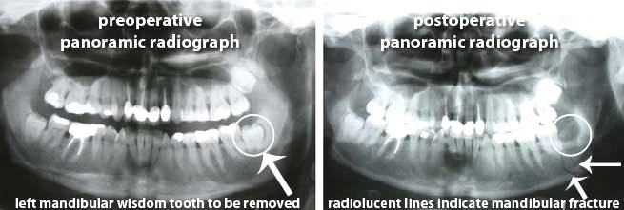
Mandible fracture
Alveolar Process Fracture
the lingual plate, alveolar plate, buccal cortical plate, palatal cortical plate, and labial cortical plate(s) may fracture during procedure.

Slide 64
-Secondary Infection
About 1 or 2 %
Signs of infection include fever above 100 degrees, abnormal swelling, pain or a salty or prolonged bad taste, with or without evidence of discharge from the surgical site.
-Injury to Adjacent Teeth
any fillings, crowns, bridges adjacent tooth etc.
-Displacement of Root Fragments into adjacent facial spaces or may be swallowed or aspirated
Exessive bleeding.
Trismus
Dislocation

Slide 65
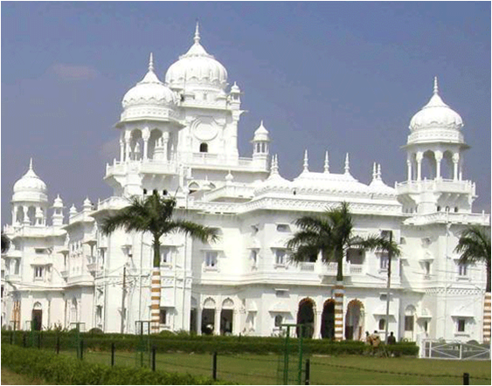
Thank you

